Slide 1
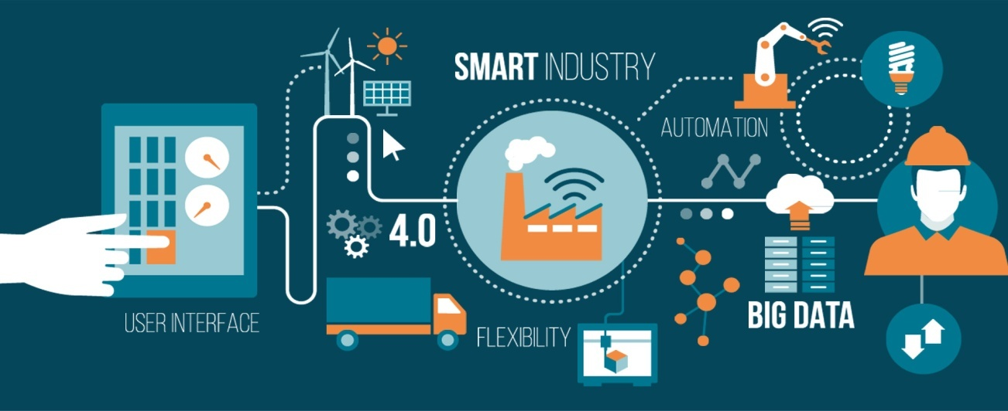
Tools and Techniques
Mastering Software Project Management Murali K, Chemuturi, Thomas M. CagelyJr, J. Ross
Prepared by: Sushish Baral

Slide 2
Contents
Software project planning
Understanding the why is project needed and needs of project
Project management plan: resources, skill sets, computer systems

Slide 3
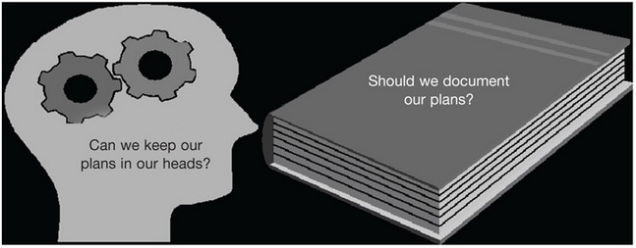
Figure 5.1. The planning dilemma.
Nobody plans to fail – they just fail to plan. – Anonymous

Slide 4
Software Project planning
Establish reasonable plans for performing the software engineering and for managing the software project.
Software Project Planning involves
developing estimates
establishing the necessary commitments,
defining the plan to perform the work.

Slide 5
Software Project Planning
The software planning begins with a statement of the work to be performed and other constraints and goals that define and bound the software project.
The software planning process includes steps to
Estimate the size of the software work products and the resources needed,
Produce a schedule,
Identify and assess software risks,
Negotiate commitments.
Iterating through these steps may be necessary to establish the plan for the software project

Slide 6
Understanding the why is project needed and needs of project
Proof of concept prototyping
Communication failure
Boring presentation
Unsatisfied clients
Uneven work
Need of repairing or rewriting

Slide 7
Why is project needed?
Except for very small projects, written documentation of a plan is a good idea.
Planning on paper has advantages:
Be reviewed
Act as a point of reference for stakeholders
Facilitate control and performance evaluation during execution
Facilitate validation of the planning parameters

Slide 8
Needs of project
Drive the scope of the project
The scope of a project usually refers to the features that will be developed and the work that will be done to implement those features. It often also includes an understanding of the features that will be excluded from the project.
Talk to main stakeholders

Slide 9
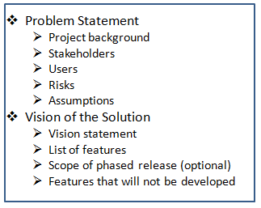
Needs of Project
Write the vision and scope document
The "vision" part refers to a description of the goal of the software
catching misunderstandings early on in the project
Table: Vision and scope document outline

Slide 10
Needs of project
Review the vision and scope document
Every stakeholder
The members of the project team
At least a few people who will actually be using the software (if they are available).

Slide 11
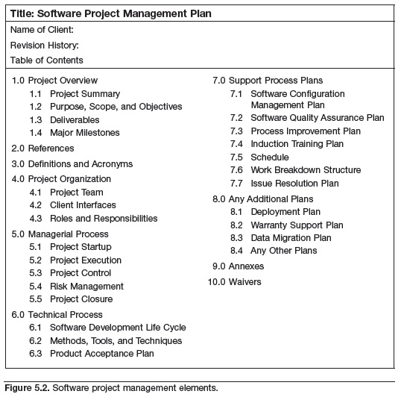
Project Management Plan (PMP)

Slide 12
Project Management Plan (PMP)
A PMP is the top-level plan that consolidates all of the relevant information about a project, from the purchase order to the initial estimates and requirements, into the plan.
The PMP also incorporates
Methods that will be used for managing the project,
Project management tools to be used,
Project milestones,
Communication protocols,
Mechanisms for escalation and issue resolution.

Slide 13
Project Management Plan (PMP)
In engineering projects,
how a project will be managed is covered in the standard operating procedures/policies (or SOPs) of an organization’s production environment or production facility.
In engineering projects, because all projects are managed similarly. Therefore, a completely new management plan for every project may be unnecessary.
In software projects, the developmental environment is completely different for almost every project, which necessitates the need to plan and document how each project will be managed.

Slide 14
Project Management Plan (PMP)
Information contained in a PMP includes:
Project demographic information
A software estimate (software size, effort, cost, and schedule)
Milestones and delivery schedules
Delivery acceptance criteria
Human resources requirements and a projected timeframe for when they will be required
Management methods (including but not limited to work allocation and management, information and source code management, quality control, communication management, etc.)
Tools to be used for the project (development tools, testing configuration tools, and project management tools, etc.)

Slide 15
(PMP) Resources
A resource plan is typically a subsection of a PMP. Once a project has been estimated, a work schedule for execution of the project can be developed. The work schedule provides details of the resources required and the dates when the resources will be needed. Attributes that influence the human resources aspects of estimation include:
Skill sets required for the project
Size of software to be developed
Amount of effort required to deliver the project
Duration that resources will be required on the project
Likely dates for resources

Slide 16
(PMP) Skill Sets
Capers Jones, a leading authority in software estimating, has said that IT has more specialties than any other profession. In a large project, therefore, a wide range of different skill sets may be needed. In addition to a project leader/SPM, several roles are typical:
Programmers
Database administrator/database specialists
Team Leaders
Software testers/testing specialists
Language smiths
Software (solution) architects
Business (systems) analysts
Configuration controller:
Process Coordinator
Other: process and product quality assurance analysts (PPQA),
user interface designers (UI), usability testers, etc.

Slide 17
(PMP) Computer Systems
Depending on the nature of the project, a project team needs various hardware items for execution of a project execution. Typical hardware and system software requirements for a project include:
Special computers (based on project needs)
Personal computers (with appropriate terminal emulation software, if necessary, to connect to the development machine/server or appropriate system software, a development tool kit, and any other necessary tools)
Networking hardware and software
Connectivity to customer machines (if the project is to be executed from a remote location)
Bandwidth (if communication with a remote customer or testing of a Web application is involved)
Special software (databases, programming languages, testing tools, configuration management tools, documentation tools, team collaboration tools, etc.)

